Slide 1
MALL CUSTOMER SEGMENTATION USING K-MEANS CLUSTERING
RISHITHA CHILUKURI
AP19110010441

Slide 2
Customer segmentation
Customer Segmentation is the subdivision of a market into discrete customer groups that share similar characteristics. Customer Segmentation can be a powerful means to identify unsatisfied customer needs. I want to increase customer lifetime value by segmenting the customers into several groups with similar characteristics and form growth strategies for each group.
clustering
Clustering algorithms try to find natural clusters in data, the various aspects of how the algorithms to cluster data can be tuned and modified. Clustering is based on the principle that items within the same cluster must be similar to each other. The data is grouped in such a way that related elements are close to each other.

Slide 3
Steps involved
1. DataSet selection
2. Data Preprocessing
3. Applying K mean
4.Clustering

Slide 4
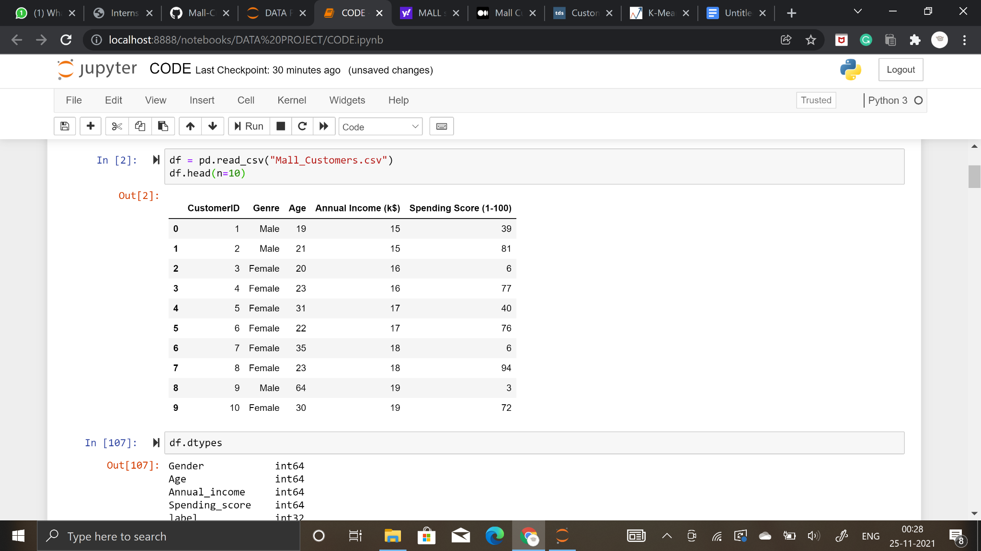
We have selected a dataset of customers in a mall which includes the following features: Customer Id,Customer Gender,Customer Age, Annual Income,Spendingscore
1

Slide 5
Dependencies: Here we can find the libraries we will use in order to develop a solution for this problem.
numpy|pandas: Will help us treat and explore the data, and execute vector and matrix operations.
matplotlib|seaborn: Will help us plot the information so we can visualize it in different ways and have a better understanding of it.
plotly: Will also help us plotting data in a fancy way.
sklearn: Will provide all necessary tools to train our models and test them afterwards

Slide 6
DATA PRE PROCESSING
removing null values
renaming errors in spellings
dropping unwanted columns
combine and replacing two columns into one.

Slide 7
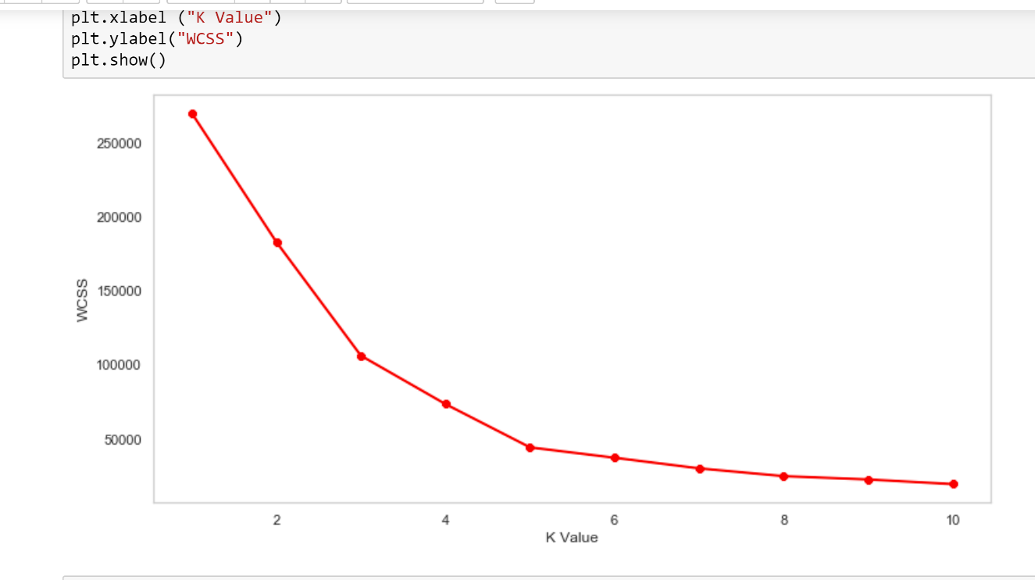
K-Means clustering is an algorithm that divides the given data into the given number of clusters. Here, the “K” is the given number of predefined clusters, that need to be created.Finding the optimal number of clusters is an important part of this algorithm. A commonly used method for finding optimal K value is Elbow Method

Slide 8
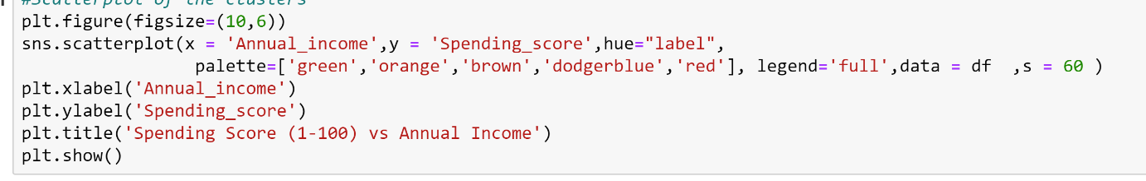
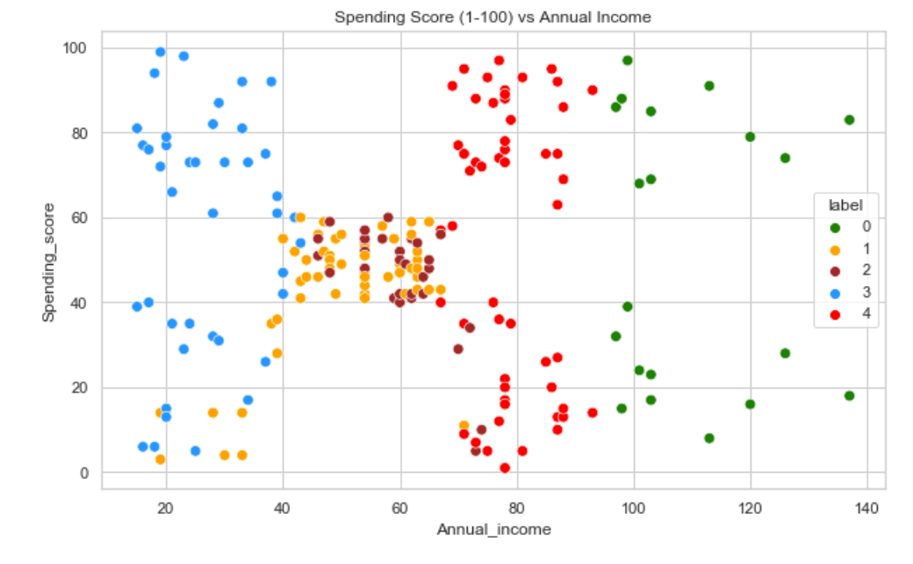
CLUSTERING (K MEAN)
Label 0(green)-people with high income and equal amount of high and low
spending score
Label 1(orange)-people with moderate income and moderate spending
Label 2(brown)-people with moderate income and moderate to low spending
Label 3(dodgerblue)-people with low income and high to low spending score
Label 4(red)-people with moderate income and equal amount of high and low
spending score

Slide 9
CONCLUSION
KMeans Clustering is a powerful technique in order to achieve a decent customer segmentation.
Customer segmentation is a good way to understand the behaviour of different customers and plan a good marketing strategy accordingly
There isn't much difference between the spending score of LABEL 4 AND LABEL 3, which leads us to think that their behaviour when it comes to shopping is pretty similar.

Slide 10
THANK
YOU

